Slide 1
Prosthetics and Motor Function: Implications for Coordination and Brain Activity
James Pierce
June 8, 2018
Advisor: Jorge M. Zuniga, Ph.D.

Slide 2
Agenda
Introduction/Background
Statement of the Problem
Theoretical Framework
Overview of Existing Literature
Methodology
Results
Discussion
Limitations
Conclusion

Slide 3
Agenda
Introduction/Background
Statement of the Problem
Theoretical Framework
Overview of Existing Literature
Methodology
Results
Discussion
Limitations
Conclusion

Slide 4
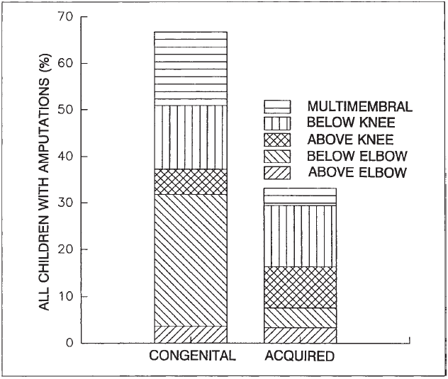
Introduction
The Centers for Disease Control and Prevention (CDC) estimate that about 1,500 babies are born with upper limb deficiencies (ULDs) every year
Most children with ULDs experience partial limb loss congenitally through Amniotic Band Syndrome (ABS)
Characterized by in utero digit or limb loss
Caused by the infiltration of fibrous connective tissue bands from the amnion into the uterus
ABS most commonly leads to amputation of the left upper limb, but can also affect other limbs
20% of children with in utero amputation have bilateral, trimembral or quadrimembral reductions
CDC cites developmental and quality of life (QoL) problems related to ULDs
Krebs D, Edelstein J, Thornby M. Prosthetic management of children with limb deficiencies. Physical Therapy. 1991;71(12):920.

Slide 5
Introduction
It has been proposed that ULDs can lead to QoL detriments such as:
Delayed or absent developmental milestones
Mobility and self-care limitations
Deficits in social acceptance
Only 1 in 9,400 of children with ULDs are considered for prosthetic fitting due to:
Rapid growth
High prosthesis cost
Lack of insurance coverage
Inadequate device functionality
Of those that receive a prosthesis, there is also a high rate of device abandonment

Slide 6
Introduction
Early age fitting and prosthesis use have been suggested to aid motor development and function
Prevalence of ULDs is too low to create high power studies determining the true value of early prosthesis fitting
Prosthesis simulators could be one option to improve the design/functionality and prescription of devices despite the small population of pediatric amputees
Much larger pool of research subjects can be made available
Amateur prosthesis conditions can be tested more easily

Slide 7
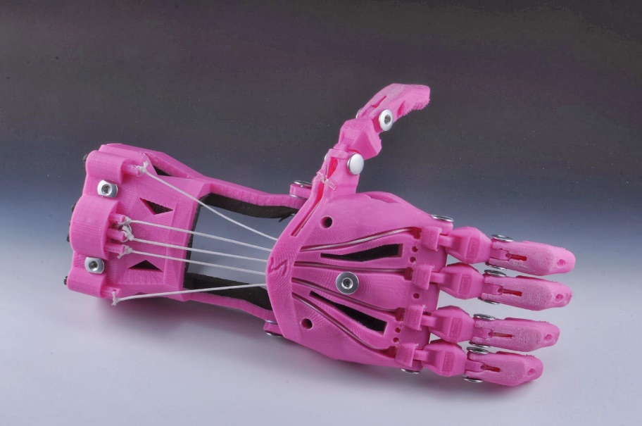
Introduction
Additive manufacturing technologies have the potential to produce prostheses that are:
More useful
Low-cost
Customizable
Quickly produced
There exists a need to evaluate prosthesis usage in a more quantifiable terms
Brain activity in the motor cortex of ULD children is unexplored
Bimanual coordination effects of prostheses are currently unknown
The quantification of these measures could provide valuable information regarding the motor control of children with ULDs
Findings could aid in the improvement of the current prosthetic rehabilitation paradigm
http://enablingthefuture.org/wp-content/uploads/2014/02/shea2.jpg

Slide 8
Agenda
Introduction/Background
Statement of the Problem
Theoretical Framework
Overview of Existing Literature
Methodology
Results
Discussion
Limitations
Conclusion

Slide 9
Purpose
To determine the influence of upper-limb prostheses and prosthetic simulators (compared to typically developing control children) on:
Brain activity in the motor cortex
Bimanual coordination

Slide 10
Aims/Hypotheses
Specific Aim 1: Determine differences in coordination and dexterity among upper-limb prosthesis, prosthetic simulator, and typically developing control groups during performance of a bimanual coordination task.
Hypothesis 1a: Bimanual coordination will be significantly higher in the control group than prosthesis and simulator groups.
Hypothesis 1b: Gross manual dexterity will be significantly higher in the control group than prosthesis and simulator groups.
Specific Aim 2: Identify the influence of upper-limb prostheses and prosthetic simulators on brain activity in the motor cortex during the performance of different motor tasks compared to typically developing control children.
Hypothesis 2a: Brain Activity in the motor cortex will be significantly increased, possibly due to exploratory movements, for both prosthetic and simulator conditions compared to the control group.
Hypothesis 2b: Brain Activity in the motor cortex will be less lateralized for both prosthetic and simulator conditions compared to the control group.
Specific Aim 3: Determine differences in perception (embodiment and agency) of the body among upper-limb prosthesis, prosthetic simulator, and TD control groups.
Hypothesis 3: Embodiment and agency of the non-preferred arm will be significantly higher in the control group compared to prosthesis users.

Slide 11
Significance
The neurological and motor control mechanisms that could explain the high prosthesis rejection rate observed in children with ULDs have not been properly examined
This information is critical to enhance our limited knowledge of how children increase the number of available motor repertoires through selection
This information would be helpful to develop rehabilitation programs aimed to:
Reduce prosthesis rejection/abandonment
Increase the functional use of the prosthesis

Slide 12
Agenda
Introduction/Background
Statement of the Problem
Theoretical Framework
Overview of Existing Literature
Methodology
Results
Discussion
Limitations
Conclusion

Slide 13
Theoretical Framework
Neuronal Group Selection Theory (NGST):
The brain is dynamically organized into neuronal networks or neuronal groups
Structure/function of these networks is influenced by development and behavior
Proposes that motor development is characterized by two phases of variation:
Primary Variability (0-1 year of age) – Motor activity is variable, exploratory, and not based on environmental conditions
Secondary Variability (> 1 year of age) – Child learns to select the most efficient motor strategy for a specific scenario based on active practice from a “variable movement repertoire”
Secondary variability of all motor functions does not obtain its adult configuration until adolescence

Slide 14
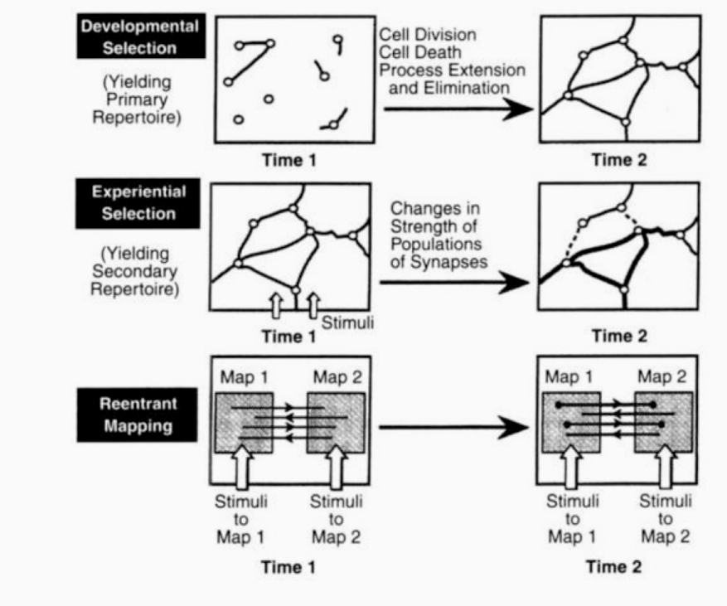
Theoretical Framework
Neuronal Group Selection Theory (NGST):
ULD children may lack a developed representation of the affected limb in the motor cortex
This underdeveloped representation likely leads to deficits in the motor repertoire for activities involving the affected limb
Prosthesis usage has been proposed as a surrogate for the missing partial limb
Has the potential to enlarge the primary neuronal networks related to the affected limb
Could lead to a richer motor repertoire
http://www.deictic.net/wp-content/uploads/2013/08/universe_7_2.png

Slide 15
Theoretical Framework
Body Schema and Body Image:
Body schema – A central, action-related representation of spatial characteristics of the body, which includes:
Length of body segments
Hierarchical structure
Form of body surfaces
Body image – The conscious visual representation of how we see our bodies from outside
Not closely related to motion control
The awareness an individual has of their body’s form
Individuals focus disproportionately more on specific body areas than on others
ULDs influence on body schema/image:
Residual limb is perceived to be smaller and shorter
Telescopes to more accurate length with prosthesis usage
Phantom limbs may be present
Much less common in congenital amputations than traumatic amputations
Prosthesis use has been shown to improve the mental representations of the affected limb over time

Slide 16
Agenda
Introduction/Background
Statement of the Problem
Theoretical Framework
Overview of Existing Literature
Methodology
Results
Discussion
Limitations
Conclusion

Slide 17
Summary of Review of Literature
Quality of Life:
Qualitative measurement tools indicate limited usefulness of prostheses as rehabilitative tools
Functionality is only significantly improved for specialized activities
Quantitative measures show potential improvements overlooked by qualitative measures
Improvements in dexterity, tactile sensation, coordinated motions of the hand, and proprioceptive feedback have been observed
Neural Representation of the Missing Limb:
Differences exist in brain regions responsible for residual limb control/proprioception
Only 20% of congenital amputees experience phantom limb sensation
Experimental activation of associated brain areas fails to elicit sensations in missing limbs
These differences may indicate modified neuronal group selection and body schema in ULD children
Neuronal groups are developed through somatosensory input, which is missing in ULDs
Similar modified neuronal group selection has been observed in cerebral palsy (CP) and developmental coordination disorder (DCD)

Slide 18
Summary of Review of Literature
Coordination:
Somatosensory deficits lead to differences in interlimb coordination
Spinal cord injury and deafferentation negatively impact coordinated and cognitively demanding motions
Handedness can cause temporal coordination deficiencies in cognitively demanding tasks
Viability of Prosthetic Simulators:
Simulators have been shown to produce similar learning effects to novice amputees
These devices can improve the power of studies performed with prostheses

Slide 19
Agenda
Introduction/Background
Statement of the Problem
Theoretical Framework
Overview of Existing Literature
Methodology
Results
Discussion
Limitations
Conclusion

Slide 20
Methodology: Participants
Two groups of children
Unilateral upper-limb deficiencies (ULD, n = 5)
Typically developing (TD, n = 5) group using a prosthesis simulator (TD-Simulator)
Typically developing control children (TD-Control)
Inclusion Criteria:
Aged 3-16 years with unilateral upper-limb congenital reductions of any digit, hand, arm, or shoulder
Any subjects with prior prosthesis experience must cease usage for at least six months prior to the study
Exclusion Criteria:
Participants with upper extremity injury within past month
Medical conditions that are contraindications for wearing a prosthesis
Skin abrasions
Musculoskeletal injuries of the upper limbs
All groups were age- and sex-matched to the ULD population
Simulator users were also matched to amputation level
Demographics
 | N | Age (Years) | Amputation Level
TD | 5 | 8.60 ± 2.79 | -
ULD | 5 | 8.80 ± 3.11 | 2 Transradial 3 Partial Hand
TD = Typically Developing; ULD = Upper Limb Deficient

Slide 21
Methodology: Recruitment
Recruitment Methods:
Referrals from industry and healthcare collaborators (ULD subjects)
Employee announcements at university campuses
Word of mouth
Mail invitations
Subjects were admitted to the study following informed assents or parental written consent as approved by the Institutional Review Board.
Children under 6 years of age required a parental permission form
Children age 6 to 18 were given an assent signed by the children and their parents

Slide 22
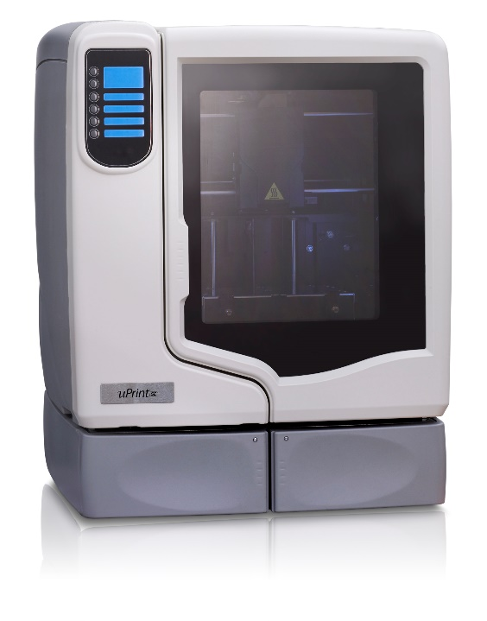
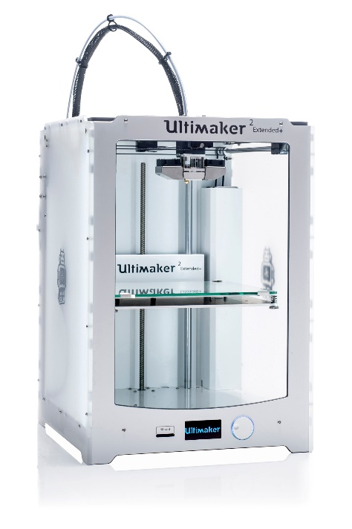
Methodology: Apparatus/Materials
3D Printer Specifications:
Prosthetic devices were manufactured on desktop and industrial 3D printers (Ultimaker 2+ Extended, Ultimaker B.V., Geldermalsen, The Netherlands and Uprint SE Plus by Stratasys, Minnesota, USA)
Prostheses were produced from polylactic acid (PLA) and acrylonitrile butadiene styrene (ABS)
https://maker13.com/wp-content/uploads/2017/04/Ultimaker-2-Extended-2.jpg
https://www.3dhubs.com/s3fs-public/uPrint_1.jpg

Slide 23
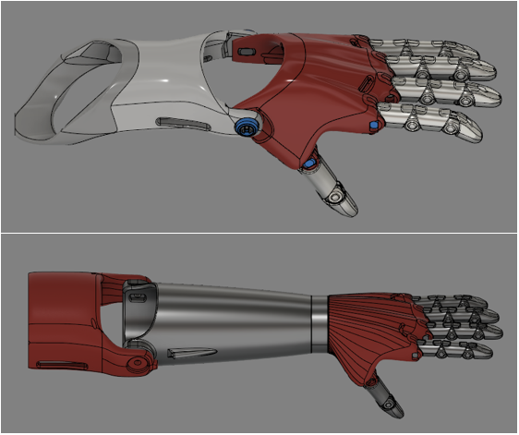
Methodology: Apparatus/Materials
Prosthetic Device/Simulator:
Body-powered, manually adjustable and produced primarily using 3D printers
Aids in the performance of bimanual and unilateral activities with a functional grasp
Index finger and thumb are oriented in opposition to facilitate cylindrical grasp and tip pinch
Silicone finger pads are added to provide enhanced traction and pliability
Voluntary-Close (VC) in grip style
Operated through the actuation of a cable attached to the ventral sides of the phalanges
Custom scaled and fitted to a specialized socket
Parts were printed at 35%-40% infill density (hexagon pattern for desktop, crosshatch for industrial)
0.15-.25 mm layer height and 0.8mm shell thickness

Slide 24
Methodology
Independent Variables:
Prosthesis conditions
No prosthesis (TD-Control)
Prosthesis simulator (TD-Simulator)
ULD Prosthesis (ULD)
Dependent Variables:
Gross manual dexterity
Temporal interlimb coordination
Embodiment and body image
Hemispheric dominance
Brain activation patterns

Slide 25
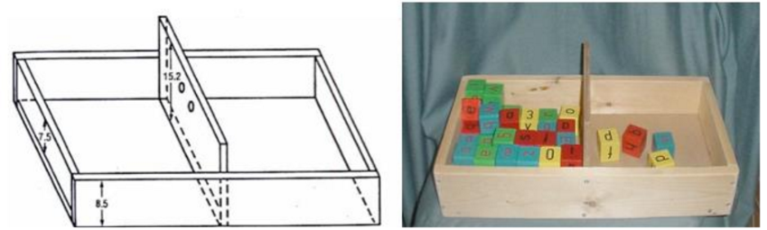
Methodology: Gross Manual Dexterity
“Box and Block” test as a measure of unilateral upper limb gross dexterity
Small, partitioned box filled with identical blocks
Number of blocks transferred between partitioned areas of the box is used as a measure of motor function
Must be transferred individually to assess dexterity
Testing takes place over 1 minute, and is repeated to ensure reliability of results
Task was performed for both preferred and non-preferred hands
Do EY, Hsiao C, Zhao C. The digital box and block test automating traditional post-stroke rehabilitation assessment. PerCom Workshop. 2013.

Slide 26
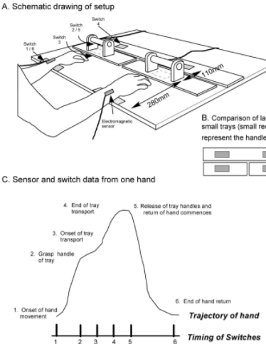
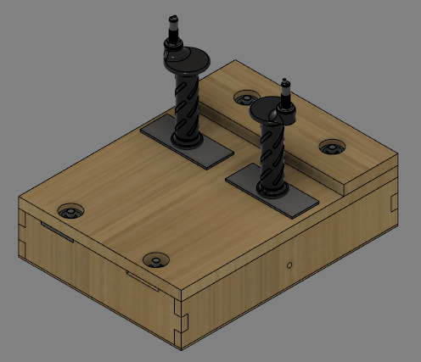
Methodology: Bimanual Coordination
Instrumented reaching tray to assess temporal coordination during reaching tasks
Relative timing for each component of task motion was recorded for both unimanual and bimanual conditions
Quantifies relative phase differences between prosthesis users, simulator users and typically developing controls
Interlimb coordination can be quantified through timing differences in sensor triggering
Closer timing corresponds with better interlimb coordination
Positive asynchrony values indicate leading task motion with preferred hand
Kilbreath SL, Crosbie J, Canning CG, Lee MJ. Inter-limb coordination in bimanual reach-to-grasp following stroke. Disability and Rehabilitation. 2009:1435.

Slide 27
Methodology: Body Schema Incorporation
Embodied Sense of Self Scale (ESSS) – Assesses the experiences of the aspects of sense of self
Three subscales:
Ownership – “This limb belongs to me”
How an item is subjectively incorporated into one’s body representation
An item is considered to be embodied when incorporated into human body representation and recognized as one’s own body parts
Agency – “I am in control of this limb”
Stems from congruence between a motor prediction and its predicted sensory feedback
Narrative – How the self extends over time
Includes identity, autobiographical memory, and intentions for the future
Body Focus Questionnaire (BFQ) – Used to gauge the relative weighting of focus on different parts of the body
Participants choose the limb they are able to envision more clearly from a pair of limbs
Nine scales of awareness for various body parts
Arms, Front/Back Side, Right/Left Side, Head, Eyes, Mouth, Stomach, Legs and Heart

Slide 28
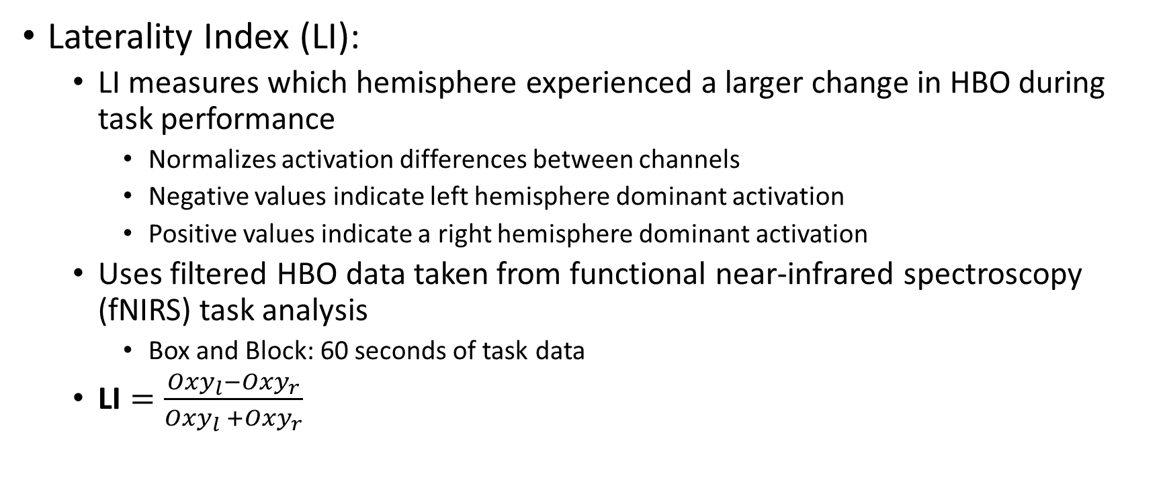
Methodology: Hemispheric Dominance
Laterality Index (LI):
LI measures which hemisphere experienced a larger change in HBO during task performance
Normalizes activation differences between channels
Negative values indicate left hemisphere dominant activation
Positive values indicate a right hemisphere dominant activation
Uses filtered HBO data taken from functional near-infrared spectroscopy (fNIRS) task analysis
Box and Block: 60 seconds of task data
$\text{LI}=\frac{Oxy_{l}−Oxy_{r}}{Oxy_{l} +Oxy_{r}}$

Slide 29
Methodology
Procedure:
3D Scanning of residual limb, anthropometric measurements, reference photographs
Design/Scaling of Prosthesis, manufacturing of the device, ensuring fit on subject
Functional Testing
Gross manual dexterity Functional Assessments Qualitative Assessments
Bimanual Coordination Brain Activation/Hemodynamics Hemispheric Dominance
Initial Fitting

Slide 30
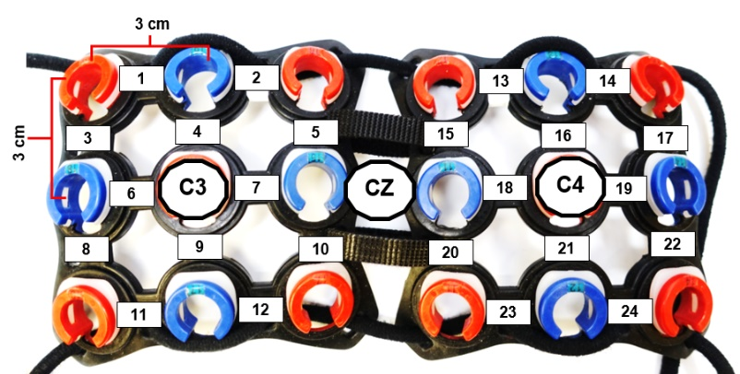
Methodology: Design
Subjects were first fitted with a continuous wave 24-channel fNIRS system (Hitachi ETG-4000, Hitachi Medical Corporation, Tokyo, Japan)
Sampling frequency of 10 Hz
Two different wavelengths will be used (695and 830 nm)
Probe set will use 10 sources and 8 detectors (3 cm spacing)
Adjustable headgear will be positioned on the head following 10–20 international system
Center of the headgear is aligned with the vertex (Cz)
Lateral channels cover the area around C3 and C4 landmarks
0.02 Hz high-pass filter and 0.5Hz low-pass filter
Removes slowly drifting signal components

Slide 31
Methodology: Design
Box and Block task was then performed for both dominant and non-dominant hands
Three times per hand
30 seconds of rest between trials
Allows fNIRS readings to return to resting baseline
Subjects then performed the bimanual coordination tasks
Three task conditions:
Unimanual reaching with each hand
Simultaneous bimanual reaching
Performed three times per condition
30 second rest period between trials
Each subject visit lasted roughly one hour
Kilbreath SL, Crosbie J, Canning CG, Lee MJ. Inter-limb coordination in bimanual reach-to-grasp following stroke. Disability and Rehabilitation. 2009:1435.

Slide 32
Methodology
Statistical Analysis:
Linear mixed model using between-subject factors and within-subject factors
Separate two-way repeated measures ANOVAs to analyze primary motor cortex activity and motor task performance.
[2 x 3; hand (non-preferred versus preferred) x group (amputee, simulator, and control)]
One-way ANOVAs were used to examine motor performance for individual hands, as well as movement asynchrony and brain laterality index
Independent t-tests were performed for the detection of significance in the survey measures
A p-value of ≤ 0.05 was considered statistically significant for all comparisons

Slide 33
Agenda
Introduction/Background
Statement of the Problem
Theoretical Framework
Overview of Existing Literature
Methodology
Results
Discussion
Limitations
Conclusion

Slide 34
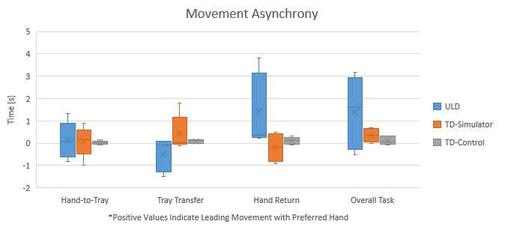
Results: Movement Synchrony
Hypothesis 1a. Bimanual coordination will be significantly higher in the control group than prosthesis and simulator groups.
Movement asynchrony was not significantly different when comparing the control group to the TD-Simulator and ULD groups for any component of task motion
General trends of coordination showed ULD participants had overall higher movement asynchrony
Overall Task Time
 | Preferred Hand | Non-Preferred Hand
Prosthesis | 9.442 ± 3.688s | 10.828 ± 5.013s
Prosthesis Simulator | 6.061 ± 2.657s | 6.421 ± 2.778s
Control | 2.102 ± 1.179s | 2.216 ± 1.306s

Slide 35
Results: Movement Synchrony
Hypothesis 1a. Bimanual coordination will be significantly higher in the control group than prosthesis and simulator groups.
ULD subjects adopted a preferred limb dominated task strategy
TD-Control subjects had closer mean asynchrony values to zero
TD-Simulator subjects tended to lead task motion with the non-preferred limb
Overall Task Time
 | Preferred Hand | Non-Preferred Hand
Prosthesis | 9.442 ± 3.688s | 10.828 ± 5.013s
Prosthesis Simulator | 6.061 ± 2.657s | 6.421 ± 2.778s
Control | 2.102 ± 1.179s | 2.216 ± 1.306s

Slide 36
Results: Movement Synchrony
Hypothesis 1a. Bimanual coordination will be significantly higher in the control group than prosthesis and simulator groups.
Assessing motor function using overall movement time shows:
ULD group takes significantly longer (p = 0.007) than both the TD-Control and TD-Simulator conditions
TD-Simulator subjects took significantly longer (p = 0.007) than TD-Control subjects
Overall Task Time
 | Preferred Hand | Non-Preferred Hand
Prosthesis | 9.442 ± 3.688s | 10.828 ± 5.013s
Prosthesis Simulator | 6.061 ± 2.657s | 6.421 ± 2.778s
Control | 2.102 ± 1.179s | 2.216 ± 1.306s

Slide 37
Results: Gross Manual Dexterity
Hypothesis 1b. Gross manual dexterity will be significantly higher in the control group than prosthesis and simulator groups.
Significant main effects were found for both limb condition (F(2,3) = 34.864, p = 0.008) and hand (F(1,4) = 63.043, p < 0.001)
Box and Block task performance was significantly lower (p = 0.008) in both TD-Simulator and ULD subjects compared to TD-Control participants
ULD and TD-Simulator subjects performed with no significant differences (p = 0.948) for the non-preferred limb
Task Performance (Blocks Transferred)
 | Preferred Hand | Non-Preferred Hand
Prosthesis | 37.40 ± 6.65 | 7.23 ± 3.37
Prosthesis Simulator | 47.60 ± 17.31 | 7.63 ± 5.61
Control | 47.60 ± 17.31 | 49.43 ± 15.21

Slide 38
Results: Brain Activation
Hypothesis 2a. Brain Activity in the motor cortex will be significantly increased, possibly due to exploratory movements, for both prosthetic and simulator conditions compared to the control group.
No significant main effects for hand (F(1,4) = 7.509, p = 0.052) and limb (F(2,3) = 0.570, p = 0.617) conditions
No interaction effect (F(2,3) = 1.092, p = 0.440)

Slide 39
Results: Brain Activation
Hypothesis 2a. Brain Activity in the motor cortex will be significantly increased, possibly due to exploratory movements, for both prosthetic and simulator conditions compared to the control group.
Independent t-test on the two hand conditions yielded significant differences between preferred (M = 0.0852 µmol, SD = 0.1525 µmol) and non-preferred (M = 0.2926 µmol, SD = 0.2856 µmol) hands; t(28) = -2.480, p = 0.019

Slide 40
Results: Laterality Index
Hypothesis 2b. Brain Activity in the motor cortex will be less lateralized for both prosthetic and simulator conditions compared to the control group.
No effects were statistically significant at the 0.05 significance level
Main effect for hand (F(1,4) = 0.136, p = 0.731) demonstrated no significant difference between preferred (M = -0.113, SD = 0.152) and non-preferred (M = -0.178, SD = 0.077) hands
Main effect for limb condition (F(2,3) = 0.212, p = 0.820) showed no significant difference between ULD (M = -0.091, SD = 0.105), TD-Simulator (M = -0.153, SD = 0.191) and TD-Control (M = -0.193, SD = 0.141) groups
The interaction effect was not significant, F(2,3) = 0.505, p = 0.647
One-way analyses of variance also showed no significance when collapsed along each set of conditions

Slide 41
Results: Laterality Index
Hypothesis 2b. Brain Activity in the motor cortex will be less lateralized for both prosthetic and simulator conditions compared to the control group.
Means and standard deviations may indicate less lateralization in the ULD population than in the TD conditions
This would support the hypothesis, but is not statistically significant

Slide 42
Results: Body Perception
Hypothesis 3. Embodiment and agency of the non-preferred arm will be significantly higher in the control group compared to prosthesis users.
For both the ESSS and BFQ, there were no significant differences in scoring between TD and ULD participants
Many expected subscales show mean differences between the two groups
Narrative, Agency and “Right” show large mean differences
 | ESSS |  |  | BFQ
 | Narrative | Agency | Embodiment | Arms Scale | "Right" Scale
ULD | 14.40 ± 5.50 | 15.20 ±5.85 | 15.40 ± 6.84 | 10.00 ± 1.41 | 13.00 ± 2.83
TD | 20.67 ± 8.14 | 23.33 ± 10.06 | 17.00 ± 7.55 | 11.00 ± 5.29 | 9.33 ± 5.13

Slide 43
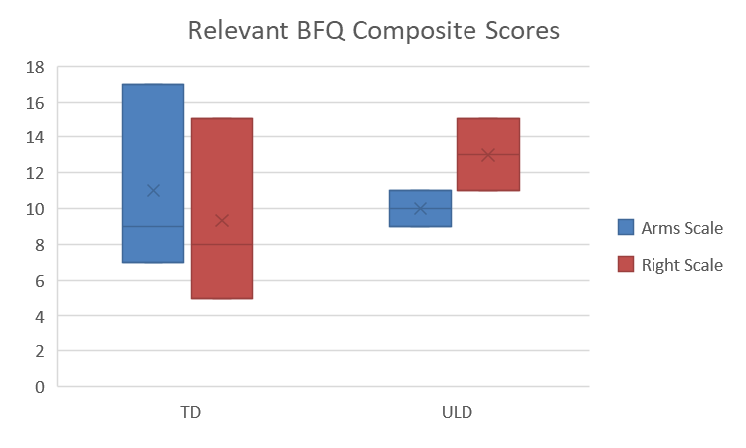
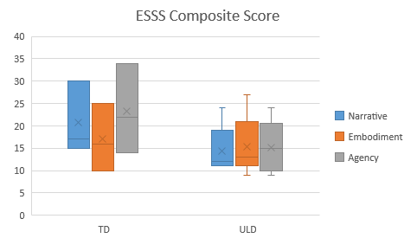
Results: Body Perception
 | ESSS |  |  | BFQ
 | Narrative | Agency | Embodiment | Arms Scale | "Right" Scale
ULD | 14.40 ± 5.50 | 15.20 ±5.85 | 15.40 ± 6.84 | 10.00 ± 1.41 | 13.00 ± 2.83
TD | 20.67 ± 8.14 | 23.33 ± 10.06 | 17.00 ± 7.55 | 11.00 ± 5.29 | 9.33 ± 5.13

Slide 44
Agenda
Introduction/Background
Statement of the Problem
Theoretical Framework
Overview of Existing Literature
Methodology
Results
Discussion
Limitations
Conclusion

Slide 45
Discussion: Movement Synchrony
Potential coordination deficits observed in bimanual reaching could indicate reduced function earlier in life than has been previously assumed
Differences in movement strategy could point to underlying neurological differences in the treatment of the prosthetic devices
Tool use vs. Embodiment
Differences in specificity of neural selection leading to altered hand dominance
Slower movements due to underdeveloped motor repertoires and exploratory movements
It is anticipated that movement strategies in the ULD group may follow similar trends to control subjects with earlier prosthesis prescription due to enhanced neuronal group selection

Slide 46
Discussion: Movement Synchrony
Slower ULD performance of bimanual task may be caused by:
Use of a novel prosthetic device
Not the only factor, due to significantly faster performance of simulator users
Differences in motor control strategies
ULD subjects may have used less efficient exploratory motions
In order to better assess the accuracy of this assessment, future studies would benefit from longitudinal testing of motor performance in all groups

Slide 47
Discussion: Prosthetic Simulators
Lack of significant differences between simulator and prosthesis users during Box and Block task could indicate that prosthetic simulators are effective surrogates for amputees
Can potentially improve statistical power and enhance iterative device design
Statistically significant (p = 0.007) differences in bimanual tasks potentially caused by:
Differences in motor repertoires
Muscle weakness/fatigue
Future direction: Inclusion of wrist flexor/extensor strength measurements as potential factor in motor performance differences

Slide 48
Discussion: Brain Activation/Laterality
Despite a lack of significance, some expected trends were observed:
Higher mean activation in prosthesis and simulator users
Lower lateralization in ULD and TD-Simulator subjects
These trends are potentially caused by:
Increased ipsilateral activation in the performance of cognitively demanding tasks
Less experience and learning with the non-preferred limb
The collection of more data to test for statistical significance should be warranted

Slide 49
Discussion: Body Perception
Lack of statistical significance is likely a result of sample size
60% response rate yielded only three responses for each survey
Some anticipated trends appear to be present in ULD subjects:
Decreased embodiment
Decreased agency
Reduced affected limb prominence
With more responses from both ULD and TD subjects, it is expected that these trends would persist and become statistically significant

Slide 50
Agenda
Introduction/Background
Statement of the Problem
Theoretical Framework
Overview of Existing Literature
Methodology
Results
Discussion
Limitations
Conclusion

Slide 51
Limitations
Equipment Limitations:
fNIRS:
Movement artifacts during testing could lead to erroneous HBO and HBR readings
Dark hair can prevent probe function
Probe placement varies based on head size
Placement is approximated based on standards, due to lack of co-registered brain image (MRI)
Low temporal accuracy
Bimanual Coordination Tray:
Some movement timing may not be captured by integrated sensors
Synchronous camera footage can be used to find timing in these cases
The tray cannot be scaled for different subject dimensions (arm length, shoulder width, etc.)

Slide 52
Possible Limitations
Experiment Limitations:
Subject Pool:
Subject pool for ULDs is small, and many have used prostheses before
Limited number of subjects restricts study population size
Prior prosthesis users are accounted for with minimum 6 month abandonment of prior prosthetic
Pediatric population limits the number of feasible fNIRS trials
Movement artifacts are common while testing children
Any erroneous movements will be documented and filtered from data
Typically developing children are matched for age and sex
Handedness is controversial for ULD subjects
Large range of subject ages and levels of amputation

Slide 53
Agenda
Introduction/Background
Statement of the Problem
Theoretical Framework
Overview of Existing Literature
Methodology
Results
Discussion
Limitations
Conclusion

Slide 54
Conclusion
Systemic deficits are present in both unimanual and bimanual motor tasks
In the performance of unimanual activities, a prosthesis simulator behaves nearly identically to an actual prosthesis user
Prosthesis simulators show promise as substitutes for ULD subjects
Performance differences with bimanual activities show that learning effects from novel device use are not the only factor in reduced performance
Prosthesis use may help to improve these motor deficits
There are no significant differences present in brain activity, brain lateralization, and perceived embodiment, agency and body image
Despite a lack of significant differences in brain activity, lateralization and body perception, many potential trends are visible in the data which warrant further exploration
Future research should explore, with a larger subject pool, fNIRS and survey measures used in this study to search for possible significance

Slide 55


Acknowledgements
People
Jorge Zuniga, PhD
Mukul Mukherjee, PhD
Ka-Chun Siu, PhD
Drew Dudley
David Salazar
Keaton Young
Walker Arce
Claudia Cortes-Reyes
Chris Copeland
Nick Than
Funding:
NASA Nebraska Space Grant Fellowship
Graduate Research and Creative Activity (GRACA) Grant

Slide 56
Questions/Suggestions?

Slide 57
References
Krebs D, Edelstein J, Thornby M. Prosthetic management of children with limb deficiencies. Physical Therapy. 1991;71(12):920.
Hadders-Algra M. The neuronal group selection theory: A framework to explain variation in normal motor development. Dev Med Child Neurol. 2000;42(8):566-572. doi: 10.1017/S0012162200001067.
Hadders-Algra M M. The neuronal group selection theory: Promising principles for understanding and treating developmental motor disorders. Dev Med Child Neurol. 2000-10;42(10):707-15.
Facts about upper and lower limb reduction defects. . 2016.
About ABS - amniotic constriction band syndrome. (n.d.).
James MA, Bagley AM, Brasington K, Lutz C, McConnell S, Molitor F. Impact of prostheses on function and quality of life for children with unilateral congenital below-the-elbow deficiency. J Bone Joint Surg Am. 2006;88(11):2356-2365.
Meurs M, Maathuis CG, Lucas C, Hadders-Algra M, van der Sluis CK. Prescription of the first prosthesis and later use in children with congenital unilateral upper limb deficiency: A systematic review. Prosthetics and Orthotics International. 2006;30(2):165-173.
Huizing K, Reinders-Messelink H, Maathuis C, Hadders-Algra M, van der Sluis CK. Age at first prosthetic fitting and later functional outcome in children and young adults with unilateral congenital below-elbow deficiency: A cross-sectional study. Prosthetics and orthotics international. 2010;34(2):166-174.
Zuniga JM, Pierce III JE, Than N, et al. Function of a 3D printed transitional prosthesis. . 2017.
Do EY, Hsiao C, Zhao C. The digital box and block test automating traditional post-stroke rehabilitation assessment. PerCom Workshop. 2013.
Korkmaz M, Erbahceci F, Ulger O. Evaluation of functionality in acquired and congenital upper extremity child amputees. Acta Orthop Traumatol Turc. 2012;46:262-268.

Slide 58
References
Dromerick A, Schabowsky C, Holley R, Monroe B, Markotic A, Lum P. Effect of training on upper-extremity prosthetic performance and motor learning: A single-case study. Arch Phys Med Rehabil. 2008;89:1199.
Tihanyi J. Body schema and body awareness of amputees. . Prosthetics and Orthotics International. 2008;32:363-382.
Imaizumi S, Asai T, Koyama S. Embodied prosthetic arm stabilizes body posture, while unembodied one perturbs it. Consciousness and Cognition. 2016;45(Supplement C):75-88. doi: https://doi.org/10.1016/j.concog.2016.08.019.
Sporns O, Edelman GM. Solving bernstein's problem: A proposal for the development of coordinated movement by selection. Child Development. 1993;64:960-981.
Polovina S, Škorić Polovina T, Polovina A, Polovina-Prološčić T. Intensive rehabilitation in children with cerebral palsy: Our view on the neuronal group selection theory. Collegium antropologicum. 2010;34(3):981-988.
Valk TA, Mouton LJ, Bongers RM. Joint-angle coordination patterns ensure stabilization of a body-plus-tool system in point-to-point movements with a rod. Frontiers in psychology. 2016;7:826.
Huinink LHB, Bouwsema H, Plettenburg DH, van der Sluis CK, Bongers RM. Learning to use a body-powered prosthesis: Changes in functionality and kinematics. Journal of NeuroEngineering and Rehabilitation. 2016;13(1):90. https://doi.org/10.1186/s12984-016-0197-7. Accessed 9/12/2017 1:16:10 PM.
Weeks DL, Wallace SA, Anderson DI. Training with an upper-limb prosthetic simulator to enhance transfer of skill across limbs. Arch Phys Med Rehabil. 2003;84. https://doi.org/10.1053/apmr.2003.50014. Accessed 9/12/2017 1:16:10 PM.
Weeks DL, Anderson DI, Wallace SA. The role of variability in practice structure when learning to use an upper-extremity prosthesis. J Prosthet Orthot. 2003;15. https://doi.org/10.1097/00008526-200307000-00006. Accessed 9/12/2017 1:16:10 PM.
Field-Fote EC, Tepavac D. Improved intralimb coordination in people with incomplete spinal cord injury following training with body weight support and electrical stimulation. Physical Therapy. 2002;82(7):707-715.
Huinink LHB, Bouwsema H, Plettenburg DH, van dS, Bongers RM. Learning to use a body-powered prosthesis: Changes in functionality and kinematics. Journal of NeuroEngineering and Rehabilitation. 2016;13(1):90. https://doi.org/10.1186/s12984-016-0197-7. doi: 10.1186/s12984-016-0197-7.

Slide 59
References
Kilbreath SL, Crosbie J, Canning CG, Lee MJ. Inter-limb coordination in bimanual reach-to-grasp following stroke. Disability and Rehabilitation. 2009:1435.
Nishiyori R, Bisconti S, Ulrich B. Motor cortex activity during functional motor skills: An fNIRS study. Brain topography. 2016;29(1):42-55.
Semjen A. Bimanual coordination during rhythmic movements in the absence of somatosensory feedback. . 2005;94.
Tian F, Delgado MR, Dhamne SC, et al. Quantification of functional near infrared spectroscopy to assess cortical reorganization in children with cerebral palsy. Opt.Express. 2010;18(25):25973-25986. http://www.opticsexpress.org/abstract.cfm?URI=oe-18-25-25973. doi: 10.1364/OE.18.025973.
Giele H, Giele C, Bower C, Allison M. The incidence and epidemiology of congenital upper limb anomalies: A total population study. The journal of hand surgery. 2001;26(4):628-634.
Canfield MA, Honein MA, Yuskiv N. National estimates and race/ethnic-specific variation of selected birth defects in the united states, 1999-2001. Birth defects research. Part A, Clinical and molecular teratology. 2006;76(11):747-756.
Resnik L, Meucci MR, Lieberman-Klinger S. Advanced upper limb prosthetic devices: Implications for upper limb prosthetic rehabilitation. Arch Phys Med Rehabil. 2012;93(4):710-717.
Resnik L. Development and testing of new upper-limb prosthetic devices: Research designs for usability testing. Journal of rehabilitation research and development. 2011;48(6):697-706.
Hadders-Algra M, Reinders-Messelink HA, Huizing K, van den Berg R, van der Sluis CK, Maathuis CGB. Use and functioning of the affected limb in children with unilateral congenital below-elbow deficiency during infancy and preschool age: A longitudinal observational multiple case study. Early Human Development. 2013;89(1):49-54. doi: https://doi.org/10.1016/j.earlhumdev.2012.07.011.
Biddiss EA, Chau TT. Upper limb prosthesis use and abandonment: A survey of the last 25 years. Prosthet Orthot Int. 2007;31. https://doi.org/10.1080/03093640600994581. Accessed 9/12/2017 1:16:10 PM.
Zuniga JM, Carson AM, Peck JM, Kalina T, Srivastava RM, Peck K. The development of a low-cost three-dimensional printed shoulder, arm, and hand prostheses for children. Prosthetics and Orthotics International. 2016.

Slide 60
References
Zuniga JM, Katsavelis D, Peck JM. Cyborg beast: A low-cost 3d-printed prosthetic hand for children with upper-limb differences. BMC research notes. 2015;8(1):10.
Zuniga JM, Peck J, Srivastava R, Katsavelis D, Carson A. An open source 3D-printed transitional hand prosthesis for children. JPO: Journal of Prosthetics and Orthotics. 2016;28(3):103-108.
Rajak BL, Gupta M, Bhatia D. Growth and advancements in neural control of limb. Biomedical Science and Engineering. 2015;3(3):46-64.
Nishiyori R. fNIRS: An emergent method to document functional cortical activity during infant movements. Frontiers in psychology. 2016;7:533.
Mathiowetz V, Wiemer D, Federman S. Grip and pinch strength: Norms for 6- to 19-year-olds. The American journal of occupational therapy. 1986;40(10):705-711.
Petersson C, Simeonsson RJ, Enskar K, Huus K. Comparing children's self-report instruments for health-related quality of life using the international classification of functioning, disability and health for children and youth (ICF- CY). Health and quality of life outcomes. 2013;11(75).
Reilly KT, Sirigu A. Motor cortex representation of the upper-limb in individuals born without a hand. PLoS One. 2011;6(4).
Shirota C, Jansa J, Diaz J, et al. On the assessment of coordination between upper extremities: Towards a common language between rehabilitation engineers, clinicians and neuroscientists. Journal of NeuroEngineering and Rehabilitation. 2016;13(1):80.
Burgess Limerick R, Abernethy B, Neal RJ. Relative phase quantifies interjoint coordination. Journal of biomechanics. 1993;26(1):91-94.
Franz EA, Rowse A, Ballantine B. Does handedness determine which hand leads in a bimanual task? Journal of Motor Behavior. 2002;34(4):402-412.

Slide 61
Review of Literature
Huizing et al. (2010):
Participants:
Twenty subjects aged 6 – 21 years
5 prosthesis users and 15 non-users
Methods:
Administered two general surveys
Given a standardized prosthesis functionality task set
Performed video analysis of common activities of daily life

Slide 62
Review of Literature
Huizing et al. (2010):
Results:
Early prosthesis adoption (< 1 year of age) significantly increased duration of prosthesis usage and overall satisfaction with prosthesis usefulness (p < 0.05)
No significant effect on gross motor function outside of specialized tasks
Conclusion: Trade-offs must be considered when adopting a prosthesis
Having an analogue for an intact arm does enrich the patients potential motor repertoires
There is an inherent reduction in sensory repertoires introduced by the prosthesis’ socket attachment

Slide 63
Review of Literature
Meurs et al. (2006):
Children fitted with a prosthesis earlier in life (< 2 years of age) were both happier and rejected their device less often (pooled Odds Ratio = 3.6, 95% CI)
Because few functional benefits were apparent, it was suggested that the decision for device fitting be left to the discretion of the clinician and the family of the patient

Slide 64
Review of Literature
Korkmaz et al. (2011):
Participants:
40 children aged 8 – 17 years (n = 20 acquired and n = 20 congenital)
Methods:
CAPP-FSI and PUFI were administered at fitting, after three weeks and after six months of use
Results:
Significant improvements for both the acquired and congenital groups
Overall upper limb functionality improved as a result of the intervention at both three weeks and six months
Tactile sensation, coordinated motions of the hand, and proprioceptive feedback were partially improved by the prosthesis

Slide 65
Review of Literature
Zuniga et al. (2017):
Participants:
Eleven children (n = 5 female) aged three to fifteen years
Methods:
Box and Block gross manual dexterity test
Tested at fitting with a 1-6 month retest
Results:
Retest gross dexterity (13.0 ± 12.7 blocks per minute) was significantly improved over baseline (6.3 ± 12.3 blocks per minute)
Indicates promise for the development of further motor skills and improvements in quality of life

Slide 66
Review of Literature
Reilly & Sirigu (2011):
Participants:
Four females with congenital ULDs (aged 25 to 38 years)
2 agenesis, 2 in utero amputations
Methods:
Transcranial Magnetic Stimulation (TMS) was used to evoke motor potentials in the hand areas of the primary motor cortex (M1)
Results:
TMS never induced the sensation that the missing limb was present
No sensations of movement in the missing limb were felt
Conclusion:
There was no readily activated neural representation for the missing limb
There may be a significant difference in the homunculus between typically developing individuals and those with ULDs

Slide 67
Review of Literature
Hadders-Algra et al. (2000):
Application of NGST to developmental abnormalities in cerebral palsy (CP) and developmental coordination disorder (DCD)
Underlying cause of functional deficits is likely due to dysfunction in neuronal groups associated with the primary motor repertoires for these actions
The author recommends reduction of sensorimotor dyscoordination as a potential rehabilitation

Slide 68
Review of Literature
Polovina et al. (2010):
Participants:
24 children aged 12 to 55 months (mean = 19.5) with CP
Methods:
Rehabilitation using intensive and variable sensorimotor stimuli as well as the passive facilitation of normal movement patterns for at least three hours per day
Results:
All dysfunction severity levels saw significant improvements in function
Many children needed reclassification into less severe classifications
Conclusion:
The reason for this difference is the controlling of sensorimotor inputs and encouragement of healthy motion in early development, which leads to more healthy neuronal group selection over the course of time

Slide 69
Review of Literature
Tihanyi et al. (2008):
Participants:
51 individuals with varied amputations
Methods:
Questionnaires for body schema and body awareness were administered
Results:
Prosthesis usage significantly improved:
Proprioception-based accuracy in both upper- and lower-limb amputees
Elongation of sensed phantom limb movement to match prosthesis length
Weight distribution during passive standing
Ownership of the affected limb

Slide 70
Review of Literature
Imaizumi et al. (2016):
Participants:
Nine subjects with ULDs
Methods:
Assessment of postural sway using a WiiFit Balance Board (Nintendo Co., Ltd., Kyoto, Japan) both with and without prosthesis
Results:
Users with a greater level of body schema incorporation over their prostheses had less postural sway while wearing the prosthesis
Non-users experienced more sway while wearing the prosthesis
Conclusion:
Prostheses can be used effectively as an analogue for an intact arm in developing postural control and coordination mechanisms if embodied

Slide 71
Review of Literature
Nishiyori et al. (2016):
Participants:
12 healthy, right-handed adults (mean age = 23.41±5.1 -years, 8 females)
Methods:
Performance of stepping in place and unimanual/bimanual reaching while being monitored by fNIRS
Results:
Significantly higher activation (HBO) in the brain hemisphere contralateral to the limb used in the performed task
Higher activation in both hemispheres during the performance of bimanual reaching activities
Reaching had consistently more lateral activation patterns than stepping

Slide 72
Review of Literature
Tian et al. (2010):
Participants:
Children aged 6-16 years with and without CP
Methods:
Repeated four-finger tapping tasks using fNIRS
Results:
Control subjects had contalateral laterality indices to that of the task limb
CP subjects had mixed contralateral and ipsilateral hemodynamic responses
As age increased, LI increased
Enhanced specialization for involved neuronal groups

Slide 73
Review of Literature
Kilbreath et al. (2006):
Participants:
13 stroke victims aged 55-77 years
Methods:
“Novel” unimanual and bimanual reaching tasks with sensorized tray
Results:
Stroke victims took significantly longer to complete the task
No significant differences between stroke victims and controls in terms of movement synchrony

Slide 74
Review of Literature
Semjen et al. (2005):
Participants:
2 deafferented subjects (one unilateral and one bilateral)
3 healthy control subjects
Methods:
Two-dimensional circle drawing task
Both hands visible, one hand visible, and no hands visible
Comfortable speed and “as fast as possible”
Results:
Significant trajectory degradation associated with restricted vision, increased speed, and opposing directions
Present in all groups, but more severe in deafferented subjects
Coordination was severely impacted by deafferentation

Slide 75
Review of Literature
Franz et al. (2002):
Participants:
Right (n = 16) and left (n = 16) handed subjects
Methods:
Circles were traced using the index finger in both symmetrical and opposing directions
Results:
Negligible difference in temporal coordination for both groups when the circles were traced in the same direction
Significant latency for opposing tracing task

Slide 76
Review of Literature
Weeks et al. (2003):
Participants:
42 right-handed adults (21 men: mean age, 22.4y; 21 women: mean age, 22.7y)
Methods:
Three conditions: dominant hand prosthesis simulator practice, non-dominant hand prosthesis simulator practice, and control
Three randomized functional tasks were performed: toggling a switch, placing a dowel in a hole, and prehension/placement of a large peg
Assessed during practice, pre-test and 24 hour post-test
Results:
Initiation time was found to improve significantly at post-test (p = 0.003) and retest (p = 0.029)
Simulator dominance had no significant effects
Movement time was also significantly lower for both practice groups than the control group (p = 0.026)

Slide 77
Review of Literature
Huizink et al. (2016):
Participants:
30 right-handed, able-bodied participants (14 males, 16 females; age 21.37 ± 1.81 years)
17 controls (7 males, 10 females; age 23.29 ± 1.45 years)
Methods:
Performing grasping tasks with spring-loaded, deformable objects of variable compressibility using a prosthetic simulator
Five training sessions over the course of two weeks
Function was assessed using the Southampton Hand Assessment Procedure (SHAP)
Results:
Significant decrease in movement time required to complete tasks (p < 0.001)
Significant decrease in hook closing time (p < 0.01)

